Slide 1
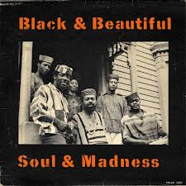
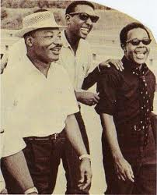
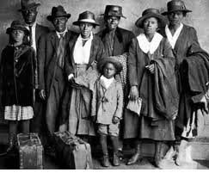
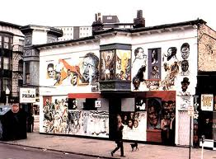

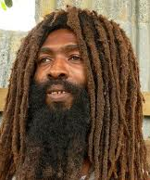
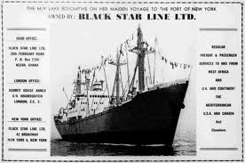
OUT
THE BOX

Slide 2
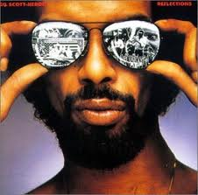
Out the BOX:
Migration:
movement through
physical space
Political culture:
ideological and
cultural change
Agency:
Icons and paradigms
as social movement infrastructure

Slide 3
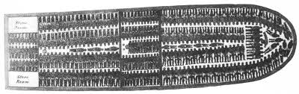
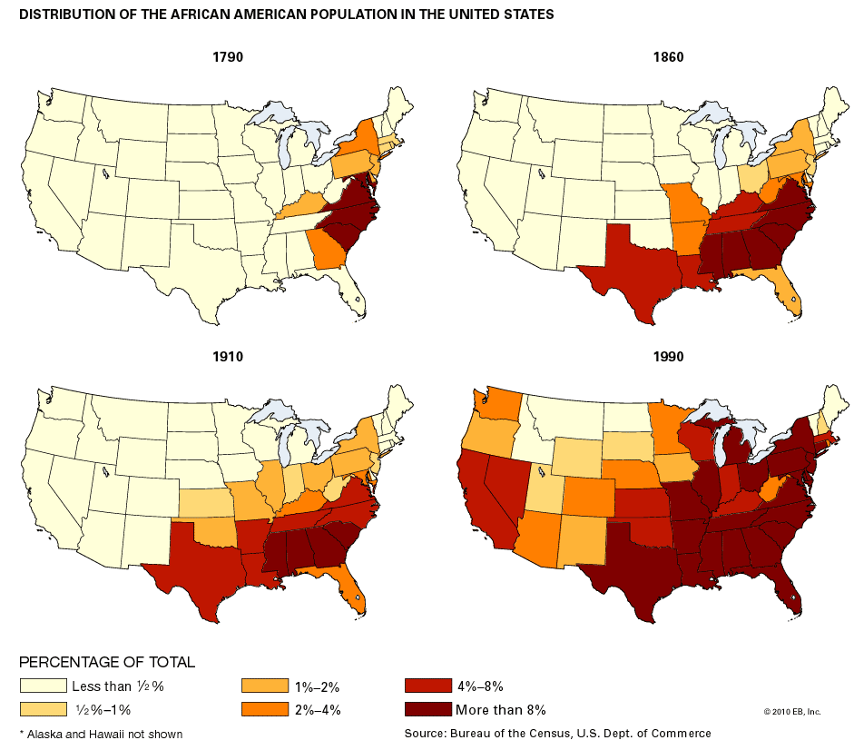
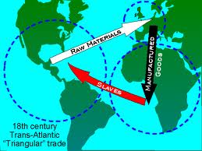
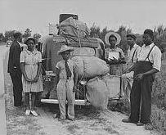
Black people have moved through
physical space getting put into the box
Trans-Atlantic Slave Trade
Movement within the US 1790-1990

Slide 4
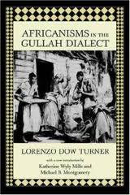

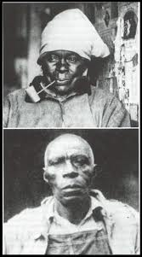
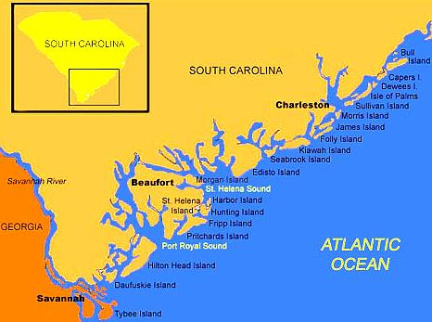
GULLAH (Geechie):
Africans who got to the
sea islands off the coasts
of South Carolina and
Georgia developed a
unique language and
culture. (Maroons)

Slide 5
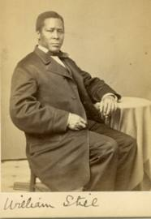
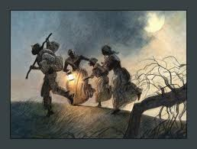
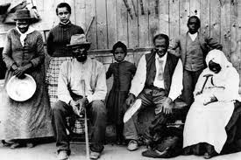
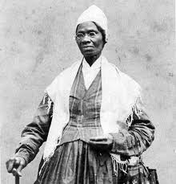
Underground Railroad
The BOX was slavery and
one way out was to run,
to escape to what was
considered freedom.
Harriet Tubman and people she led out of slavery.
Sojourner Truth

Slide 6
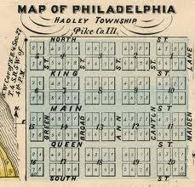
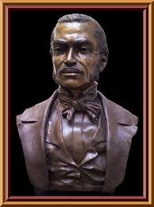
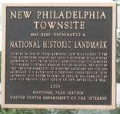
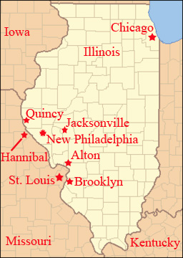
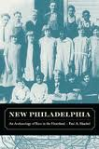
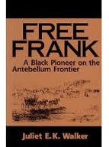
Frank McWorter (1777 – 1854)
Purchased his freedom and 16
family members. He was the
first Black Man to legally found
a town in the US - 1836. Free
Black people, some in integrated
couples, lived 20 miles from
slavery. His town was a station
on the Underground Railroad.

Slide 7
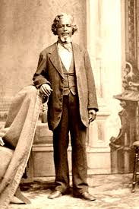
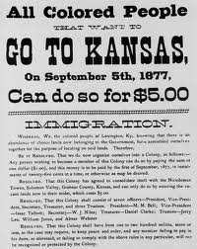
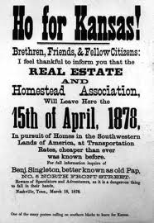
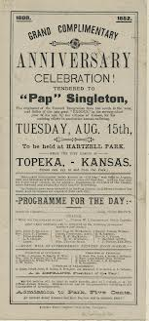
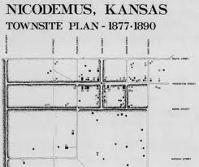
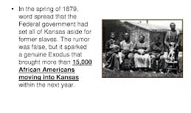
Exodusters

Slide 8

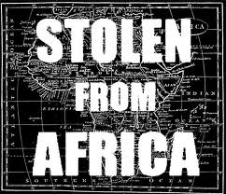
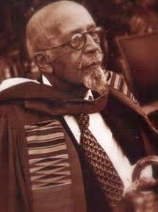
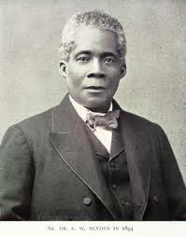
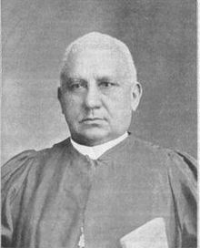
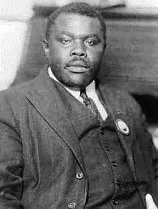
Who had forgotten?
W E B DuBois
1868 - 1963
Dr. Edward Blyden
1832 - 1912
Rev Henry McNeil Turner
1834 - 1915
Marcus Garvey
1887 - 1940

Slide 9
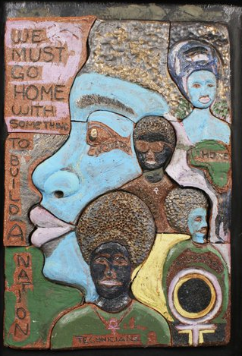
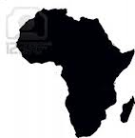
Out the Box:
Political Culture
Pan Africanism:
Identity focused on
the African
Diaspora
Nationalism:
Identity focused on
trans-generational
Black continuity

Slide 10
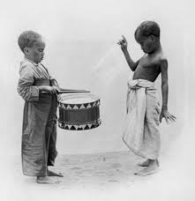
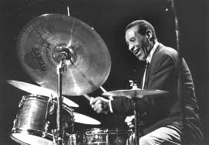
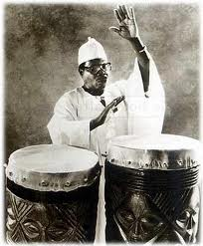
African Retentions:
We have always been linked
to our African ancestors
Music, language, food, names, religion, cultural values, and aesthetics

Slide 11
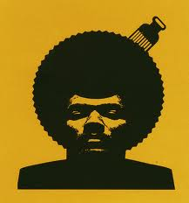
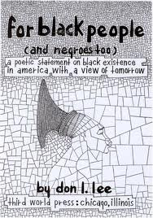

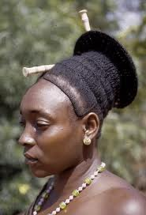
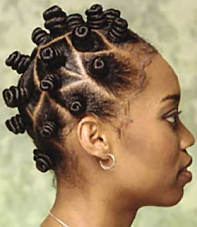
New African Cultural Renaissance

Slide 12

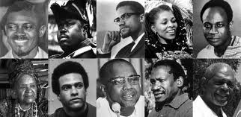
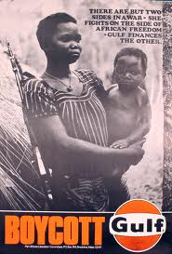

Pan-Africanism = the liberation of the African continent
1945 5th Pan African Congress Manchester, England
1974 6th Pan African Congress Dar es Salaam, Tanzania
1994 7th Pan African Congress Kampala, Uganda
UN Africa Year (1960)
Black Power Conferences
(1967-1968)
Congress of African
Peoples (1970-1980)
African Liberation
Support Committee
(1972 -1975)
Trans-Africa (1977 - )

Slide 13
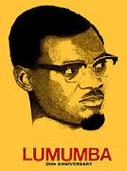
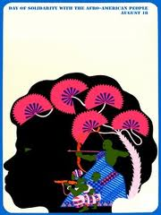
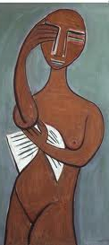
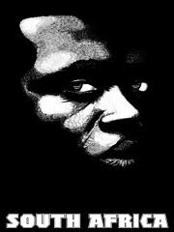




Cuba

Slide 14


W.E.B. DuBois

Slide 15




Marcus Garvey
“The Black skin is not a
badge of shame, but
rather a glorious symbol
of national greatness.”

Slide 16



Nationalism
What is a nation? A national is a historically
constituted stable community of people who
share a common territory, a language,
economic life, and culture (trans-generational).
Black Nationalist flag
Black Belt Nation thesis
The City is the Black man’s Land

Slide 17

Booker T Washington
“No white American ever thinks that any other race is wholly civilized until he wears the white man’s clothes, eats the white man’s food, speaks the white man’s language, and professes the white man’s religion.”
“You measure the size of the accomplishment by the obstacles you have to overcome to reach your goals.”
(1940 US stamp)

Slide 18









Religious nationalism

Slide 19







Economic nationalism

Slide 20







Political nationalism

Slide 21



The importance of Detroit
Last US stop on the Underground
Railroad before Canada
Concentration of Black workers at
the heart of industry
Highest per capita home
ownership of Black families
Massive racist attack in 1943
Becoming a Black city
Largest chapter of the NAACP
Home of Motown

Slide 22



Detroit Out the BOX
Republic of New Africa
Black Journal
Broadside Press
Church of the Black Madonna

Slide 23


Chicago Black controlled institutions
Chicago:
Nationalist movements
  Nation of Islam
  Moorish Science Temple
  Washington Park Forum
Black book stores
  Hammurabi
  Curtis Ellis
Museums and libraries
  South Side Community Art Center
  DuSable Museum
  Vivian Harsh Collection

Slide 24

Black Studies in the community, cont’d
4. Publications
  Ebony/Negro Digest
  Defender
  Muhammad Speaks
Organizations
a. Negro History Roundtable
  b. ANECA (American Negro Emancipation Centennial Authority)
  c. OBAC (Organization of Black American Culture)
  d. AACM (Association for the Advancement of Creative Musicians)
6. Individuals
  Ish Flory
  Margaret Burroughs
  Hoyt Fuller
  Marion Perkins

Slide 25


Why be out the box?
Can you be in and be in the way you want?
Can you be in and stay in?
Can you be in and be cool with those who are out?

Slide 26


Out the Box + In the Box = ?

Slide 27

AGENCY

